Slide 1

Intelligent Seasoner
Term Project Proposal
110-1 Embedded System Labs
2021/11/19

Slide 2
Outline
How it works? (Flow)
Why Intelligent Seasoner? (Motivation)
How to implement?
Possible Challenges
Feedback

Slide 3
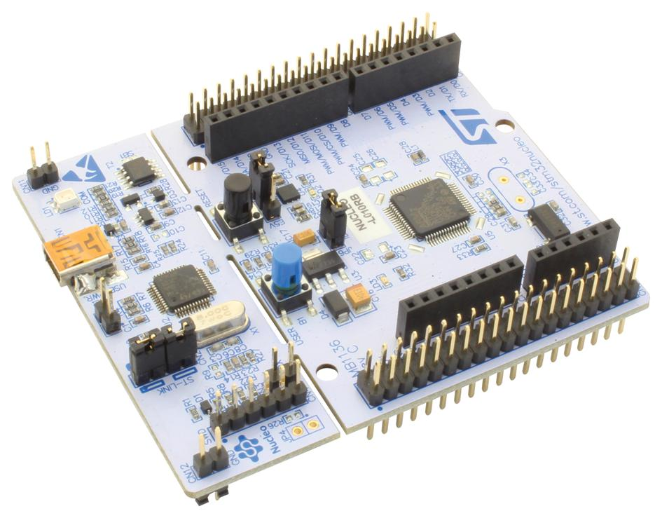
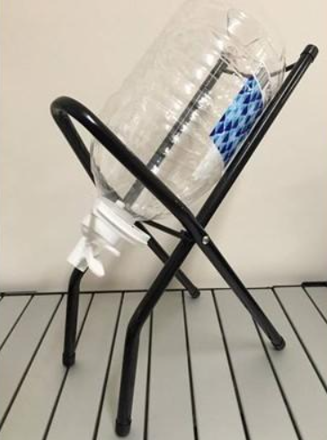
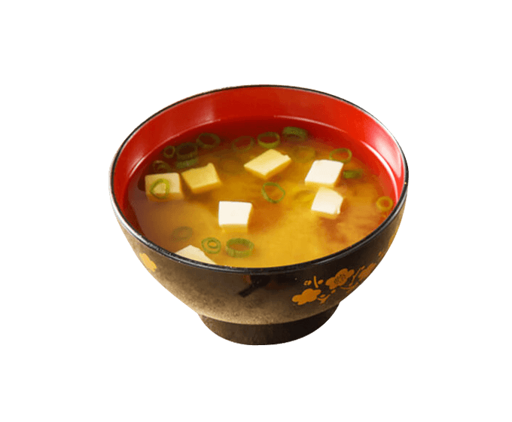
Flow
Camera to read salinity
Servo Motor
Salinity meter
Servo Motor
Servo Motor
Stirring rod
NaCl
H₂O

Slide 4
Motivation
When we buy soups in some stores, the soups may not be salty or thick enough as we expected.
We want to make the soup as flavored as we preferred.

Slide 5

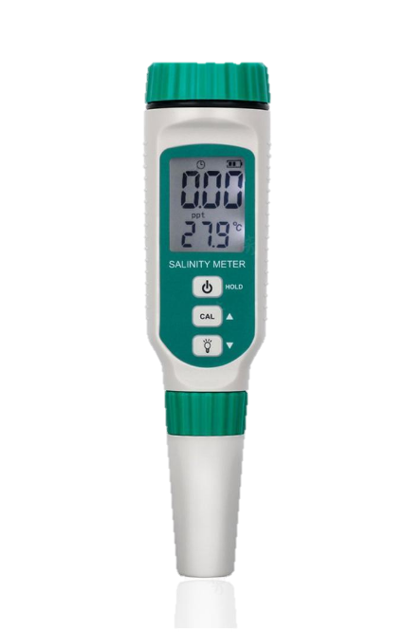
Implementation
STM32
Arduino
Salinity
Controller
Output
Drainer
Stirring rod
Sense salinity
Salinity meter
Camera
Add water
Add salt

Slide 6
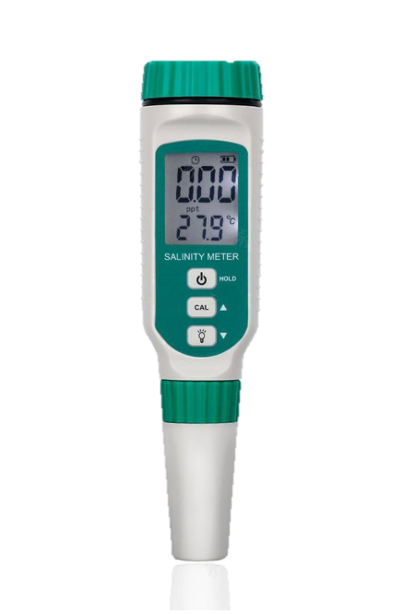
Possible Challenges
Conductivity may be influenced by temperature.
Need Correction
The response time of sensing data may be too long, which depends mainly on salinity meters.
How to control the flow of water/salt?
How does camera read the value on the salinity meter?

Slide 7
Feedback

Slide 8
Thank You

